Slide 1
Molecular Biology Biol 480
Lecture 33 April 24th , 2019

Slide 2
Announcements/Assignments
Nice job! Dakota, Beverly, Sidni
May 1—Start at 10:00 am
Brody
Dayo
Shyla
Zach
No Class Friday---Family trip to see my daughter run in South Dakota. Please nap or study during regular class time.

Slide 3
Where were we?...Gene expression regulation in Eukaryotes
The path to active RNA and proteins takes many steps/factors.
Access to DNA where the gene is located
Transcription of the gene
Post transcriptional processing of the RNA transcript
Export from the nucleus—and mRNA stability.
Translation (if protein encoding gene)
Posttranslational modifications
All steps are themselves points of regulation of gene expression

Slide 4
What have we seen?
Increasing access to gene regulatory regions---MyoD can lead to chromatin remodeling (opening) of regulatory regions in muscle-specific genes.
Transcription activation—several examples
POSTTRANSCRIPTION
Sequence-specific mRNA destruction –RNAi, miRNA
Innate differences in mRNA stability (prokaryotes vs. eukaryotes, specific mRNAs in eukaryotes. “mRNA turnover”

Slide 5
mRNA turnover
RNAs have a characteristic life-span called its half-life( t_{1/2})
Different RNAs can vary considerably in t_{1/2} from minutes to hours or months.
Some mRNA in oocytes is stable for years.
**The longer the mRNA lasts the more protein can be potentially made.
Eukaryotic mRNAs can lose stability/degrade via 3 primary mechanisms—with some of the “signals” for destruction in the 5’ and 3’ UTRs

Slide 6
Eukaryotic mRNA may be degraded in basically 3 ways:
1. Loss of polyA tail
De-capping—removal fo the 7-meG cap. This also makes the mRNA a target for digestion by RNases from the 5’ end.
Cleavage internally by RNA endonucleases. Likewise, creating smaller RNA fragments, induces digestion by exonucleases.

Slide 7
Some aspects of mRNA turnover are linked to translation of the mRNA or levels of the mRNA’s protein product.
Example –tubulin mRNA

Slide 8
Iron levels affect 2 mRNAs needed for Iron transport and uptake

Slide 9
Cool system!

Slide 10
Other control points for gene expression. What happens to eukaryotic mRNA after transcription? Usually splicing!
Recall, anything that inhibits or speeds splicing will affect rate of production of an active protein.
Alternative splicing is a great example of how splicing can significantly change what type of protein is translated.
We looked at mRNA of calcitonin gene alternatively spliced in 2 different cell types.
EXTENSIVE alternative splicing in Dscam gene in Drosophila
Alternative splicing affecting sex determination in Drosophila

Slide 11
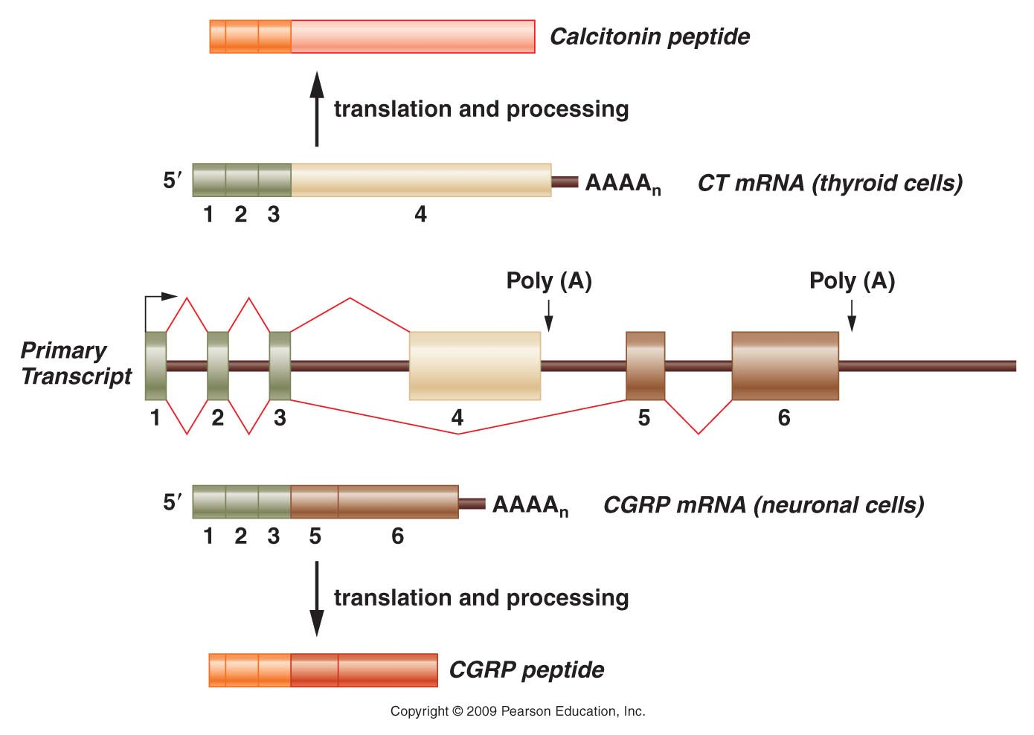
Figure 18.18
Notes:
Figure 18-18 Alternative splicing of the CT/CGRP gene transcript. The primary transcript, which is shown in the middle of the diagram, contains six exons. The primary transcript can be spliced into two different mRNAs, both containing the first three exons but differing in their final exons. The CT mRNA contains exon 4, with polyadenylation occurring at the end of the fourth exon. The CGRP mRNA contains exons 5 and 6, and polyadenylation occurs at the end of exon 6. The CT mRNA is produced in thyroid cells. After translation, the resulting protein is processed into the calcitonin peptide. In contrast, the CGRP mRNA is produced in neuronal cells, and after translation, its protein product is processed into the CGRP peptide.

Slide 12
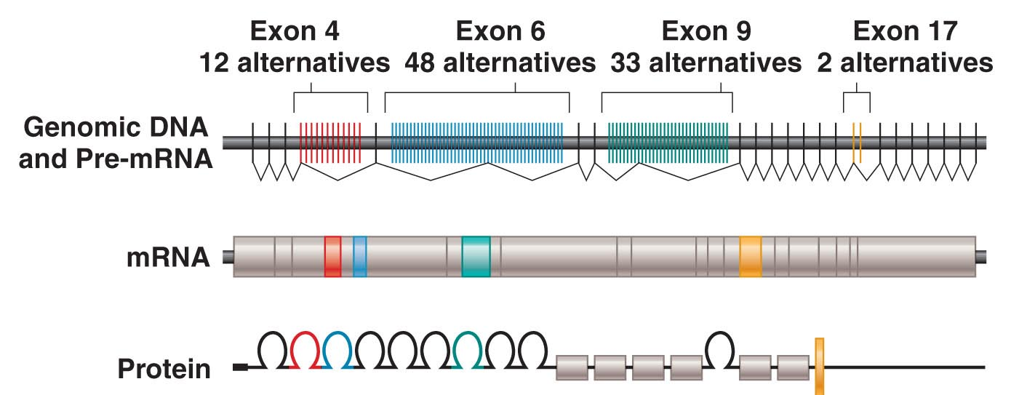
Figure 18.19
Notes:
Figure 18-19 Alterntive splicing of the Dscam gene mRNA. (Top) Organization of the Dscam gene in Drosophila melanogaster and the transcribed pre-mRNA. Each mRNA will contain one of the 12 possible exons for exon 4 (red), one of the 48 possible exons for exon 6 (blue), one of 33 for exon 9 (green), and one of 2 for exon 17 (yellow). If all possible combinations of these exons are used, the Dscam gene can encode 38,016 different versions of the DSCAM protein.

Slide 13
Drosophila sex is determined by alternative splicing
You may have learned that Drosophila sex works like mammals—XX=female and XY=male
Actually sex is the result of a specific ratio of X-chromosomes to autosomes.
1X: 2 sets of autosomes leads to male development (even with no Y chromosome )
2X: 2 sets of autosomes leads to female development.

Slide 14
3 genes are responsible for sex development
sxl
tra
dsx
When ratio X:A=1, sxl is transcribed and translated. This female-specific protein regulates female-specific splicing of the tra mRNA, which in turn regulates female-specific splicing of the dsx mRNA.

Slide 15
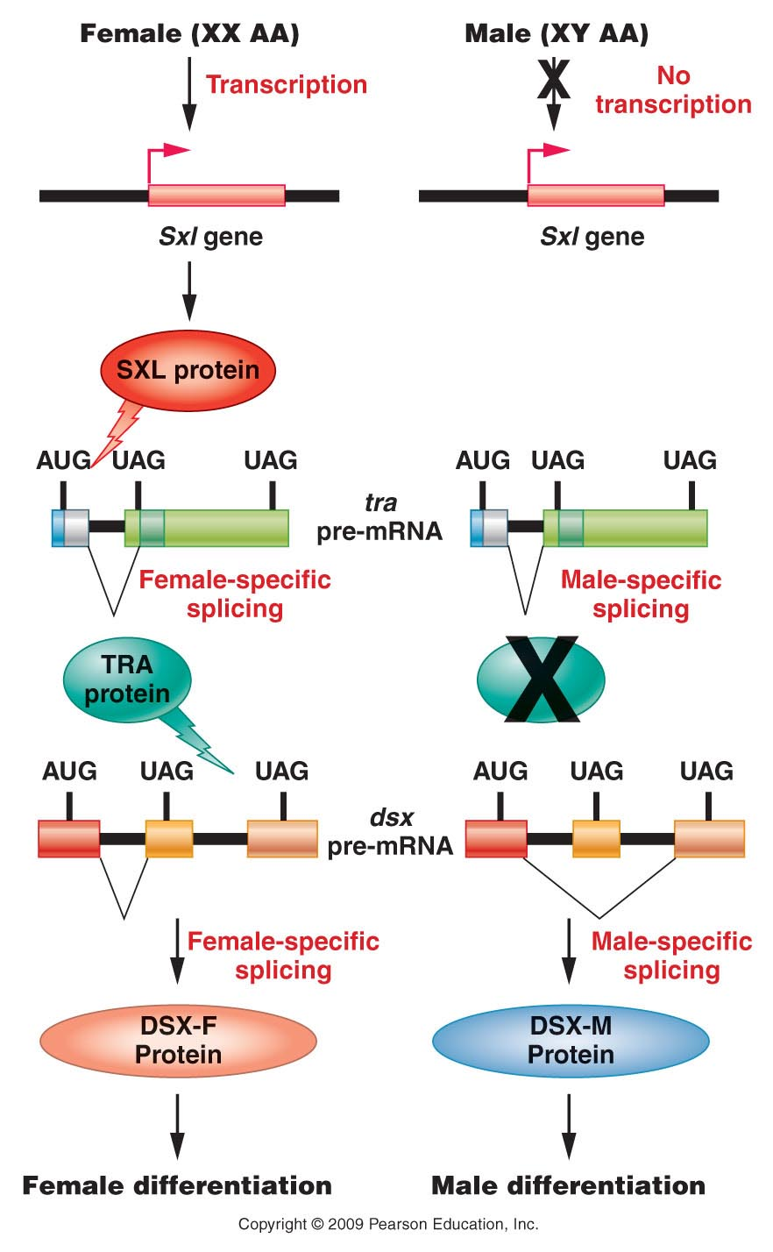
Figure 18.20
Notes:
Figure 18-20 Regulation of pre-mRNA splicing that determines male and female sexual development in Drosophila. The ratio of X chromosomes to autosomes affects transcription of the Sxl gene. The presence of SXL protein begins a cascade of pre-mRNA splicing events that culminate in female-specific gene expression and production of the DSX-F transcription factor. In the absence of SXL protein, a male-specific pattern of pre-mRNA splicing results in male-specific patterns of gene expression induced by the DSX-M protein.

Slide 16
Translation regulation
Review Translation mechanism figures---note/recall that translation initiation requires initiation factors (IF proteins).
It is not enough to have transcribed mRNA, ribosomes, and charged tRNAs---translation itself is regulated buy protein factors.

Slide 17
Recall….
We have already touched on some ways in which mRNA is physically blocked from access by ribosomes.
Translation can be physically impeded.
By mRNA secondary structure IRE sequence which forms stem loop and binds inhibitory proteins.
By binding of complementary RNA sequence to mRNA (miRNA):
Leading to cleavage of the mRNA into fragments
Blocking access to ribosomes or progression of ribosomes
Leading to decapping and deadenylation

Slide 18
Cool system!

Slide 20
Translation repression
As you’ve seen/heard, mRNA in the cytoplasm is available for translation, unless translation is regulated.
Translation regulation, then, primarily involves different mechanisms of translation repression.
For example:
translation initiation repression
translation elongation repression

Slide 22
Recall, both prokaryotes and eukaryotes require protein factors for translation initiation as well as translation elongation. Depletion or inactivation of these proteins diminish the efficiency of translation initiation and/or elongation.
Great example of translation regulation is in hemoglobin production in rbcs. Developing rbcs make mostly hemoglobin and few other proteins. But without iron/heme there is no point in making hemoglobin. Translaton of the hemoglobin α and β mRNAs is inhibited. How?

Slide 23
Regulation is at the level of an important initiation factor eIF-2-a.
A heme sensitive factor called HCR is a kinase that phosphorylates eIF-2-a. (HCR is only active in the absence of heme.)
The phosphorylated form of eIF-2-a binds to and inactivates eIF-2-b, which is necessary to activate the whole eIF-2 complex by exchanging GTP for GDP---(G-protein activation). In its in active form the eIF-2 complex can help the small ribosomal subunit bind to tRNA^{met} to initiate translation.
When eIF-2-b is phosphorylated, translation initiation is inhibited.

Slide 25
Other examples of translation control exist…most involving initiation factor activation/inactivation by other proteins.
Keep in mind, most translation regulation will affect any mRNAs already made and present in the cytoplasm…not a gene-specific mechanism.

Slide 26
Posttranslational gene regulation
Would include virtually anything that modifies the newly translated proteins that makes it functional.
We discussed some post-translational modifications.
Trimming of the protein
Additions of carbohydrates, lipids, etc.

Slide 27
Insulin
One of the best examples of post-translational modifications/activation.
It actually undergoes multiple cleavages to produce the active form of insulin needed for blood sugar regulation.

Slide 28
Insulin is one of those proteins translated in the ER.

Slide 29
Protein stability
If you think about it…none of the pre-translation regulation points in gene expression would be useful, if proteins were infinitely stable. ( once made, always available and active)
Therefore, proteins must turn over—be made, used and degraded.

Slide 30
Is that regulated?
Yes! There are examples of mechanisms for both stabilizing and for destabilizing proteins.
i.e. The p53 protein. One of the most important tumor suppressor proteins, made in all cell types. It’s considered a master regulator for cell division and it’s absence is noted in ~50% of cancer types.

Slide 31
P53 is needed to stop cell division in cells that have DNA damage and in certain instances p53 induces apoptosis in badly damaged cells.
In cells that aren’t damaged, p53 is not needed and high levels of active p53 actually harm the cell/organism.
P53 is regulated by post-translational activation and stability mechanism

Slide 32
In normal cells, with no DNA damage or other stresses, a protein called Mdm2 binds to p53 keeping it inactive as well as promoting binding of another protein---ubiquitin.
Ubiquitin, when bound to proteins, marks those proteins for digestion with proteases.

Slide 33
In times of cellular stress, or when DNA damage is detected, Mdm2 is phosphorylated, resulting in the release of p53---so that p53 can induce cell repair or apoptosis.
Interestingly, as p53 accumulates, it acts as a transcription factor for Mdm2 gene---so that activity of p53 is not sustained too long. P53 induces the transcription of its inhibitor!

Slide 35
Ubiquitin
P53 is not, by any means, the only protein that is marked for destruction by ubiquitin. As you may have guessed, ubiquitin is a ubiquitous protein in cells. It’s general role is protein turn over….making sure proteins don’t linger longer than needed.
http://en.wikipedia.org/wiki/Ubiquitin

Slide 36
In a series of steps, ubiquitin is attached to proteins, which then marks those proteins for transport to a cellular structure called the proteosome. This is a large multiprotein complex that degrades proteins, strips of ubiquitin and recycles amino acids.

Slide 37
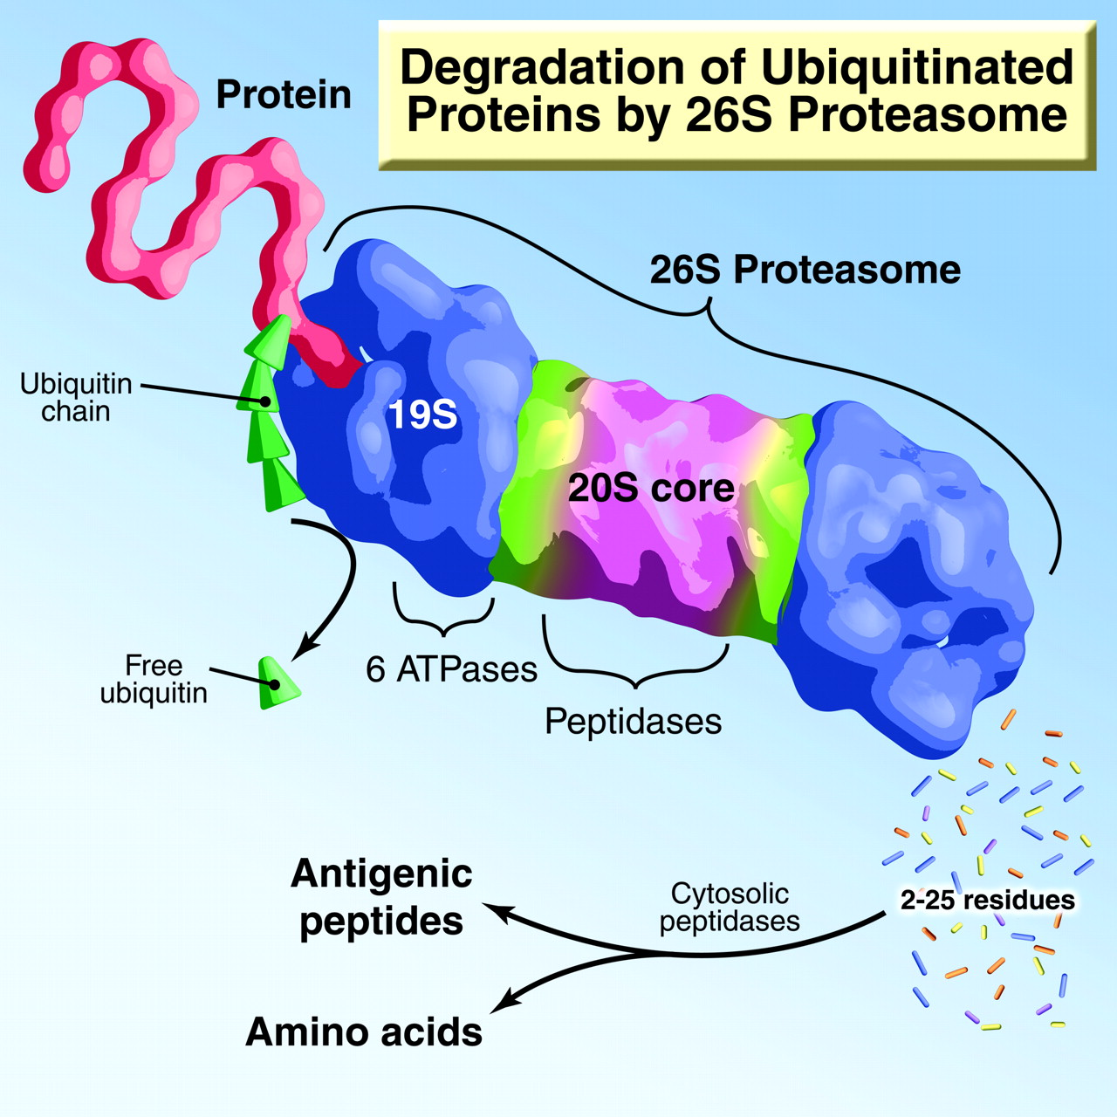

Slide 38
Next time…
We will finish up eukaryotic gene expression by starting at the beginning! A few genes are regulated pre-transcription----at the level of the DNA.
What? I thought the genome/recipe was unchangeable, in terms of DNA sequence, once we inherited it.
Read and be ready to discuss section 17-2

